Slide 1


SME support measures
Train the adviser pilot initiative
Dec 2021

Slide 2
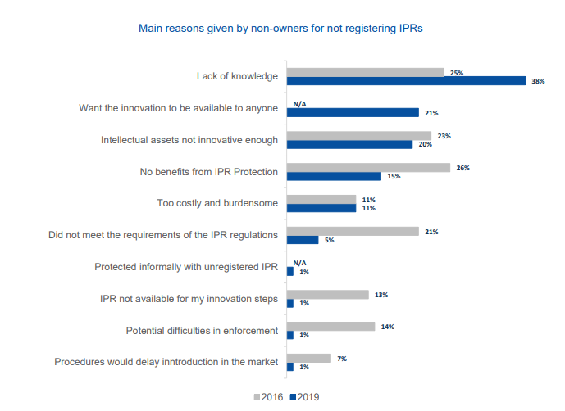
Train the adviser pilot initiative
BACKGROUND
2019 SME Scoreboard

Slide 3
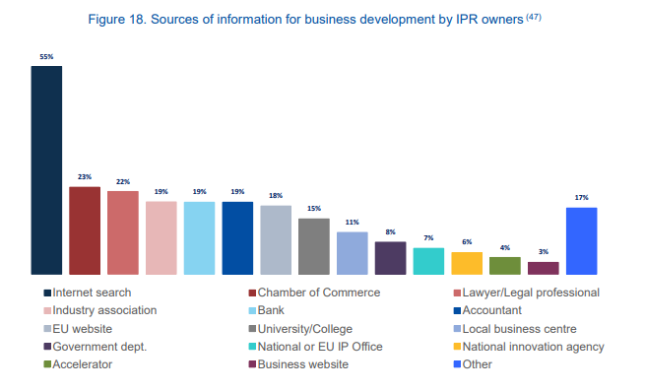
Train the adviser pilot initiative
BACKGROUND
19%
Accountant
2019 SME Scoreboard

Slide 4
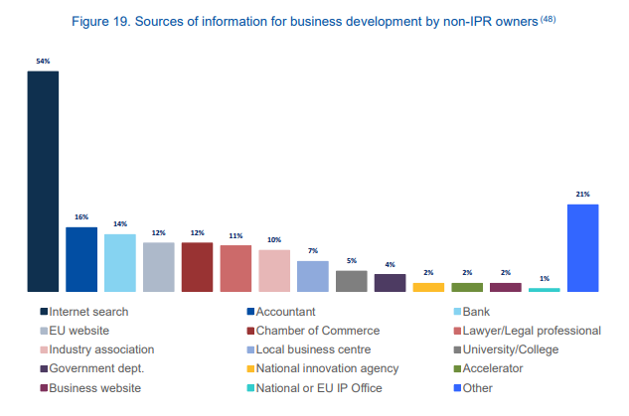
Train the adviser pilot initiative
BACKGROUND
16%
Accountant
2019 SME Scoreboard

Slide 5
Train the adviser pilot initiative
BACKGROUND
Vast majority of SMEs have an accountant.
Accountants are a relevant and trustworthy source of advice.
Accountancy
Business advisory
Usually play a double role

Slide 6
Train the adviser pilot initiative
TRAIN THE ADVISOR
TRAIN THE ADVISER
First hand Intellectual Property (IP) information to be able to…
Spot situations where IP protection is needed
Support and protect your
client’s business
Know the IP basics
Awareness to the clients

Slide 7
Train the adviser pilot initiative
TRAIN THE ADVISOR PACKAGE
TRAIN THE ADVISER PACKAGE
The package* contains
Introductory virtual presentation (30/45) mins
Train the adviser virtual workshop (approx. 3,5 hours**)
Hint of IP for accountants with business cases
Practical session on how to detect and boost IP opportunities for clients
Handout (check-list) and support channels
E-learning module (coming soon) business advisers
Reference step-by-step guide to explore IP opportunities with clients EUIPO support channels and additional material
Self-paced online training on how to identify IP opportunities
*Certificate of completion if all parts are completed.
**1 half day.

Slide 8
Train the adviser pilot initiative
SHORT TERM PROPOSAL
SHORT TERM PROPOSAL
What we aim to deliver:
1
3
Run a pilot in EN/ES
of a 30’ presentation following a workshop* addressed to selected stakeholders
Design a Train
the advisor offer with a calendar combining workshops** and
e-learning.
2
Compile feedback and make improvements
E-learning module
available after workshops
*During 2022.
**1 workshop per annual quarter.

Slide 9
Train the adviser pilot initiative
MEDIUM/LONG TERM PROPOSAL
MEDIUM/LONG TERM PROPOSAL
What we aim to deliver:
Workshops (advanced level/specific topics)
Permanent offer with a calendar potentially combining
e-learning (basic)
Increase content offer
Personalisation
Variety of subjects:
Accountancy
Innovation process
IP valuation
Monetisation of IP rights
Marketing and IP
Complexity/level of expertise

Slide 10
Train the adviser pilot initiative
QUESTIONS AND DOUBTS
QUESTION AND DOUBTS
Questions?

Slide 11
Train the adviser pilot initiative
QUESTIONS AND DOUBTS
QUESTION
Are you interested in
participating
in these pilot training

Slide 12

@EU_IPO
euipo
EUIPO.eu
THANK YOU

