Slide 1
The Future of Corporate Reporting
London, 16 May 2016
Mark Vaessen
Chair FEE Corporate Reporting Policy Group
Notes:
Introductory Section and 4 chapters
Growing Audience
Content: Financial and Non-financial reporting
Core and More
Approach to Policy Making and Innovation
Focus on TECHNOLOGY as driver and enabler of change

Slide 2
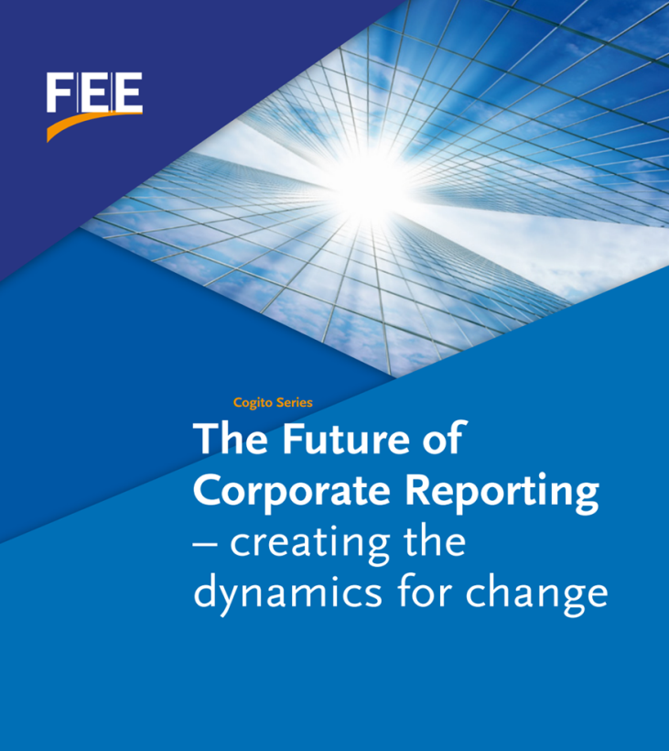
FEE fostering the debate
Growing audience
Content: financial and non-financial reporting
Core & More
Approach to policy making and innovation
TECHNOLOGY as driver and enabler of change
Notes:
This is what we at FEE have been trying to do with a project we just finalised. This project looks at the future of corporate reporting. It will be published next week and I invite you to download it from our website.
Reporting is an essential instrument of corporate governance. There is no good decision making, no accountability without information and transparency.
In the past century, financial statements were one of the main sources of information for investors to base their investment decisions on. That was the age where tangible assets, bricks and mortar, hardware were defining most of a company’s value and paper was the main mean of communication.
Reporting today: paper based, long, detailed and complex; mostly shareholders centric but we see gradually more non financial information
Therefore what we see today is that financial statements are only one of many sources of information, and they seldom impact share prices (unless they report unexpected surprises).
Today is the age of intangibles: business value is mostly driven by: the quality of R&D and innovation capacity; IP; ability to built and retain talent; environmental footprint; reputation and brand; ability to drive a sustainable business model for the long term.
These issues are not necessarily well captured by current financial statements, and investors look at many other sources of information – analyst presentations; trading updates; earnings releases etc. to find the information that is relevant to them.
So, with Darwin in mind, we thought we had to consider the future of corporate reporting.

Slide 3
Financial statements (FS) losing “market share"
Unstructured
Decision-making information
Other sources
Structured
Financial statements
1950
Year
2016
Notes:
This slide is one I borrowed from a now retired KPMG US partner, who was also AICPA president, Bob Elliott. He used this slide at the end of the 90’s. I have updated it to now, but the analysis hew made then is till even more valid today.
That is:
In the past century, financial statements were one of the main sources of information for investors to base their investment decisions on. That was the age of tangible assets - PPE, bricks and mortar, hardware – defining most of a company’s value.
Now, fast forward to the current information age, financial statements are only one of many sources of information, and they seldom impact share prices (unless they report unexpected surprises). This is the age of intangible assets, other factors driving the business value – the quality of your R&D, innovation pipeline; IP; know how of distribution; quality of people; ability to built and retain management talent; ability to drive a sustainable business model for the long term. Non of these issues are captured by financial statements, so investors look at many other sources of information – analyst presentations; trading updates; earnings releases etc. to find the information that is relevant to them

Slide 4
Growing audience
Accountability to a wider group of stakeholders
Multiple reports not sustainable
Two way communication
Technology
Growing access
Growing interest
Growing audience
Technology

Slide 5
Corporate information
Financial
Non-financial
More timely and less voluminous
Driven by relevance, not compliance
Key for a complete picture
Move towards global principles-based reporting framework
Connected
Think screen, not paper/PDF
Notes:
Connection between financial and non-financial
Many new requirements/standards

Slide 6
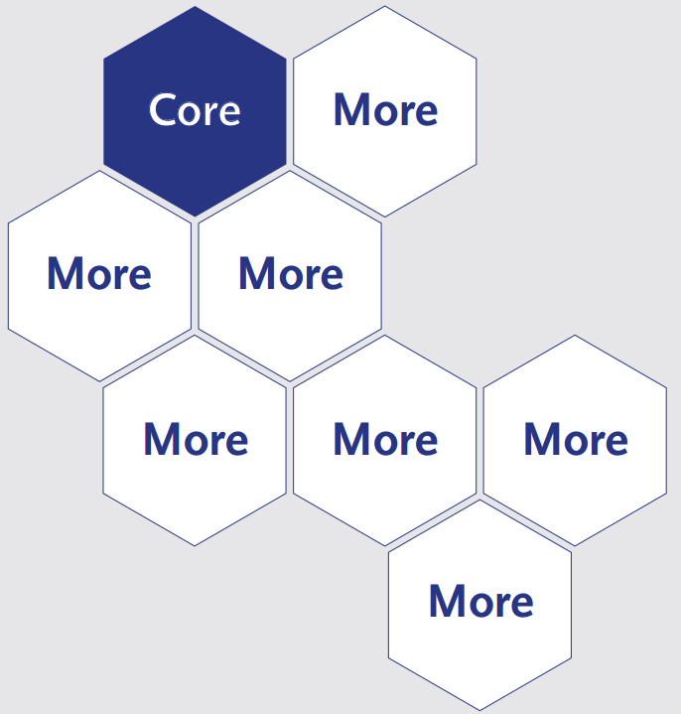
CORE & MORE
One CORE (summary) report
MORE reports
Financial, notes, ESG, country-by country, tax transparency, etc.
Can be accessed via drilling down vertically and horizontally
Technology is key!
Update dynamic/periodic/adhoc elements
Notes:
Periodic update: e.g. every hour
Ad hoc update: e.g. when a new video is available
Dynamic update: Whenever something important happens

Slide 7
Future of Corporate Reporting and
Need for debate and experimentation
Is there agreement on the issues to be solved?
If yes, who should own the agenda?
<IR> is the most developed and promising initiative
<IR> could become the CORE report
FEE wants to be a constructive, but critical partner with<IR>

Slide 8
Policy making and innovation
Remove barriers to innovation
Allow parallel experimental reporting
See compliance as a means to an end – added value
Coordinate stakeholders, policy-makers and standard setters

Slide 9
Join the debate
Discussion paper http://bit.ly/15futurecorprep
FEE welcomes responses by 30 June 2016
For updates, follow #FutureCorporateReporting
Join our LinkedIn group https://www.linkedin.com/groups/8417453
Notes:
Key Questions on Technology
How technology drives and enables the changes for the audience corporate reporting?
How can technology assist in the innovation in financial reporting?
What is the role of technology in the CORE & MORE?

Slide 10
Stay connected
FEE website
Monthly e-newsletter
Connect with European Professional Accountants
@FEE_Brussels
@FEE_SMP

